Slide 1
Recurrent Neural Networks
성균관대학교 소프트웨어학과
이 지 형

Slide 2
Contents
Sequential Data Processing
Recurrent Neural Networks
Long Short-Term Memory (LSTM)

Slide 3
Sequential Data Processing
What is sequential data?
What do we have to consider for sequential data processing?

Slide 4
Recurrent Neural Networks
Connections form cycles
x₁
h₁
o₁
x₂
h₂
o₂
…
…
…
x_{m}
h_{k}
o_{n}
c₁
c₂
…
c_{k}

Slide 5
Recurrent Neural Networks
Connections form cycles
x₁
h₁
o₁
x₂
h₂
o₂
…
…
…
x_{m}
h_{k}
o_{n}
c₁
c₂
…
c_{k}

Slide 6
Recurrent Neural Networks
Connections form cycles
x₁
h₁
o₁
x₂
h₂
o₂
…
…
…
x_{m}
h_{k}
o_{n}
c₁
c₂
…
c_{k}

Slide 7
Recurrent Neural Networks
Connections form cycles
x₁
h₁
o₁
x₂
h₂
o₂
…
…
…
x_{m}
h_{k}
o_{n}
c₁
c₂
…
c_{k}

Slide 8
Recurrent Neural Networks
Connections form cycles
x₁
h₁
o₁
x₂
h₂
o₂
…
…
…
x_{m}
h_{k}
o_{n}
c₁
c₂
…
c_{k}

Slide 9
Recurrent Neural Networks
Connections form cycles
x₁
h₁
o₁
x₂
h₂
o₂
…
…
…
x_{m}
h_{k}
o_{n}
c₁
c₂
…
c_{k}

Slide 10
Recurrent Neural Networks
Connections form cycles
x₁
h₁
o₁
x₂
h₂
o₂
…
…
…
x_{m}
h_{k}
o_{n}
c₁
c₂
…
c_{k}

Slide 11
Recurrent Neural Networks
Connections form cycles
x₁
h₁
o₁
x₂
h₂
o₂
…
…
…
x_{m}
h_{k}
o_{n}
c₁
c₂
…
c_{k}

Slide 12
Recurrent Neural Networks
Connections form cycles
x₁
h₁
o₁
x₂
h₂
o₂
…
…
…
x_{m}
h_{k}
o_{n}
c₁
x_{t}
h_{t}
o_{t}
c₂
…
h_{t-1}
c_{k}

Slide 13





Recurrent Neural Networks
Connections form cycles
𝒙_{𝒕}: input at time 𝒕
h_{𝒕}: hidden state at time 𝒕
𝒇: is an activation function
U, V, W: network parameters
RNN shares the same parameters across all time steps
g: activation function for the output layer
o_{t}
$$V$$
$$W$$
$$h_{t}=f\left(Ux_{t}+Wh_{t−1}\right)$$
h_{t-1}
h_{t}
$$\left.o_{t}=g(Vh_{t}\right)$$
$$U$$
x_{t}

Slide 14
Recurrent Neural Networks
Connections form cycles
o_{t}
$$V$$
$$W$$
$$h_{t}=f\left(Ux_{t}+Wh_{t−1}\right)$$
h_{t-1}
h_{t}
$$\left.o_{t}=g(Vh_{t}\right)$$
$$U$$
x_{t}
x₁
x₂
x₃
x₄
x₅

Slide 15
Recurrent Neural Networks
Connections form cycles
o_{t}
$$V$$
$$W$$
$$h_{t}=f\left(Ux_{t}+Wh_{t−1}\right)$$
h_{t-1}
h_{t}
$$\left.o_{t}=g(Vh_{t}\right)$$
$$U$$
x_{t}
o₁
h₀
h₁
x₁

Slide 16
Recurrent Neural Networks
Connections form cycles
o_{t}
$$V$$
$$W$$
$$h_{t}=f\left(Ux_{t}+Wh_{t−1}\right)$$
h_{t-1}
h_{t}
$$\left.o_{t}=g(Vh_{t}\right)$$
$$U$$
x_{t}
o₂
h₁
h₂
x₂

Slide 17
Recurrent Neural Networks
Connections form cycles
o_{t}
$$V$$
$$W$$
$$h_{t}=f\left(Ux_{t}+Wh_{t−1}\right)$$
h_{t-1}
h_{t}
$$\left.o_{t}=g(Vh_{t}\right)$$
$$U$$
x_{t}
o₃
h₂
h₃
x₃

Slide 18
Recurrent Neural Networks
Connections form cycles
o_{t}
$$V$$
$$W$$
$$h_{t}=f\left(Ux_{t}+Wh_{t−1}\right)$$
h_{t-1}
h_{t}
$$\left.o_{t}=g(Vh_{t}\right)$$
$$U$$
x_{t}
o₄
h₃
h₄
x₄

Slide 19
Recurrent Neural Networks
Connections form cycles
o_{t}
$$V$$
$$W$$
$$h_{t}=f\left(Ux_{t}+Wh_{t−1}\right)$$
h_{t-1}
h_{t}
$$\left.o_{t}=g(Vh_{t}\right)$$
$$U$$
x_{t}
o₅
h₄
h₅
x₅

Slide 20
Recurrent Neural Networks
Connections form cycles
o_{t}
$$V$$
$$W$$
$$h_{t}=f\left(Ux_{t}+Wh_{t−1}\right)$$
h_{t-1}
h_{t}
$$\left.o_{t}=g(Vh_{t}\right)$$
$$U$$
x_{t}
o₁
o₂
o₃
o₄
o₅
h₁
h₂
h₃
h₄
h₅
x₁
x₂
x₃
x₄
x₅

Slide 21
Recurrent Neural Networks
Long Term Dependency
x₁~x_{t-1} are encoded into h_{t-1}
h_{t-1} has the information on the past
It is a context to process x_{t}
o₅
h₁
h₂
h₃
h₄
h₅
x₁
x₂
x₃
x₄
x₅

Slide 22




Recurrent Neural Networks
Long Term Dependency of Standard RNN
However, it may exponentially decade or grow
Usually it is limited to 10 steps
o₁
o₂
o₃
o₄
o₅
$$W$$
$$W$$
$$W$$
$$W$$
h₁
h₂
h₃
h₄
h₅
x₁
x₂
x₃
x₄
x₅

Slide 23
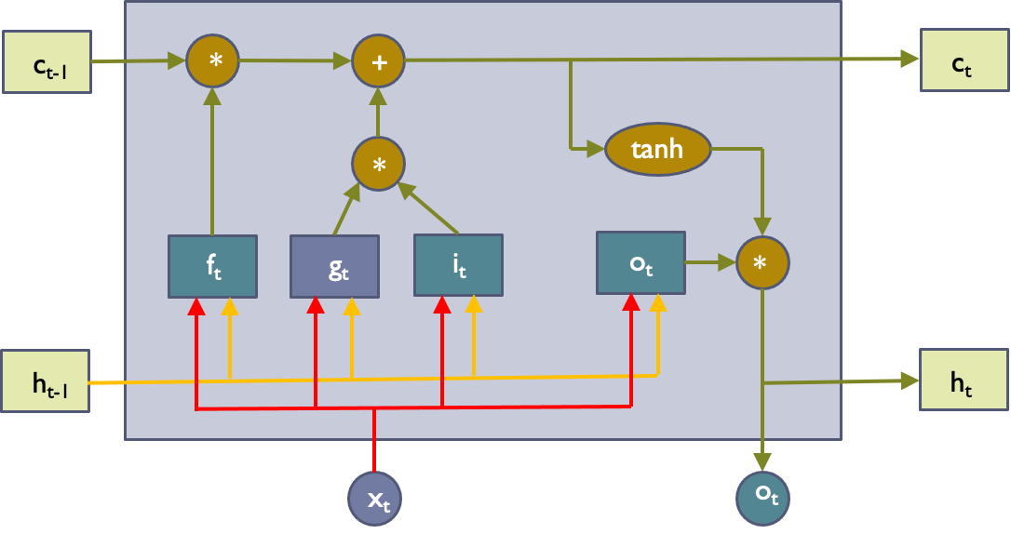
Long Short-Term Memory (LSTM)
Capable of learning long-term dependencies.
LSTM networks introduce a new structure called a memory cell
An LSTM can learn to bridge time intervals in excess of 1000 steps
Gate units that learn to open and close access to the past
Input gate
Forget gate
Output gate
Neuron with a self-recurrent

Slide 24
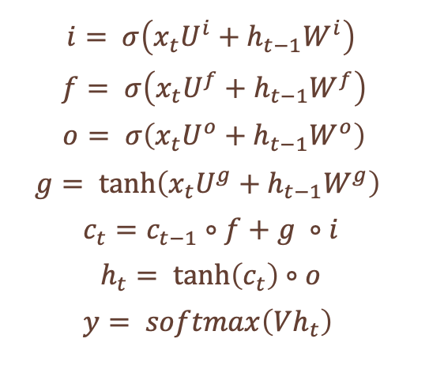
Long Short-Term Memory (LSTM)
Equations
𝒊: input gate
𝒇: forget gate
𝒐: output gate
𝒈: self-recurrent
𝒄_{𝒕}: internal memory
h_{𝒕}: hidden state
𝐲: final output
$$i= σ\left(x_{t}U^{i}+h_{t−1}W^{i}\right)$$
$$f= σ\left(x_{t}U^{f}+h_{t−1}W^{f}\right)$$
$$o= σ\left(x_{t}U^{o}+h_{t−1}W^{o}\right)$$
$$g= \tanh\left(x_{t}U^{g}+h_{t−1}W^{g}\right)$$
$$c_{t}=c_{t−1}∘f+g ∘i$$
$$h_{t}= \tanh\left(c_{t}\right)∘o$$
$$y= softmax\left(Vh_{t}\right)$$

Slide 25



Long Short-Term Memory (LSTM)
o_{t}
$$V$$
How to work
$$W$$
h_{t-1}
h_{t}
$$U$$
x_{t}
c_{t}
c_{t-1}
+
c_{t}
tanh
g_{t}
g_{t}
h_{t-1}
h_{t}
x_{t}
o_{t}

Slide 26
Long Short-Term Memory (LSTM)
o_{t}
$$V$$
How to work
$$W$$
h_{t-1}
h_{t}
$$U$$
x_{t}
c_{t-1}
*
+
c_{t}
tanh
f_{t}
g_{t}
h_{t-1}
h_{t}
x_{t}
o_{t}

Slide 27
Long Short-Term Memory (LSTM)
o_{t}
$$V$$
How to work
$$W$$
h_{t-1}
h_{t}
$$U$$
x_{t}
c_{t-1}
*
+
c_{t}
tanh
*
f_{t}
g_{t}
i_{t}
h_{t-1}
h_{t}
x_{t}
o_{t}

Slide 28
Long Short-Term Memory (LSTM)
o_{t}
$$V$$
How to work
$$W$$
h_{t-1}
h_{t}
$$U$$
x_{t}
c_{t-1}
*
+
c_{t}
tanh
*
f_{t}
g_{t}
i_{t}
o_{t}
*
h_{t-1}
h_{t}
x_{t}
o_{t}

Slide 29
Long Short-Term Memory (LSTM)
Gradient Flow
No Gradient Vanishing
c_{t-1}
*
+
c_{t}
tanh
*
f_{t}
g_{t}
i_{t}
o_{t}
*
h_{t-1}
h_{t}
x_{t}
o_{t}

Slide 30
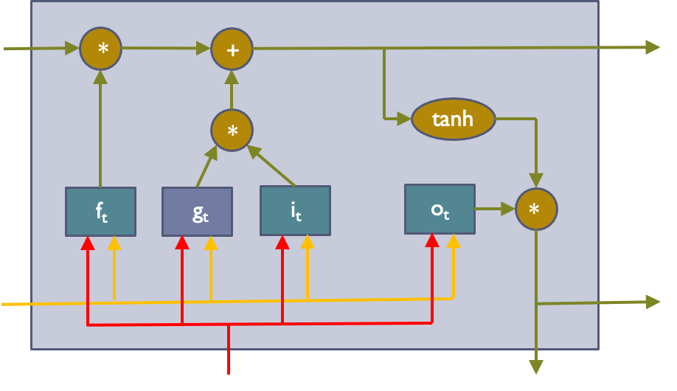
Long Short-Term Memory (LSTM)
Gradient Flow
Uninterrupted Gradient Flow
C₀
C₁
C₂
C₃
h₀
h₁
h₂
h₃
x₁
o₁
x₂
o₂
x₃
o₃
Similar to ResNet!
3x3 conv, 128
3x3 conv, 128
3x3 conv, 128
3x3 conv, 128
3x3 conv, 128
3x3 conv, 128 / 2
3x3 conv, 64
3x3 conv, 64
3x3 conv, 64
3x3 conv, 64
3x3 conv, 64
3x3 conv, 64
Pool
7x7 conv, 64 / 2 Input
Softmax FC 1000
Pool
3x3 conv, 64
3x3 conv, 64
3x3 conv, 64
3x3 conv, 64
3x3 conv, 64
3x3 conv, 64
...

Slide 31
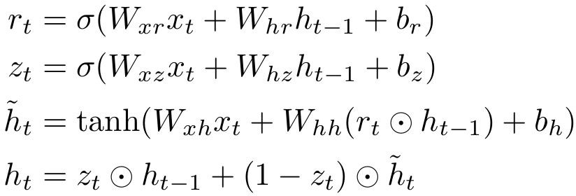
Gated Recurrent Units
Structure
*
tanh
*
1-z_{t}
r_{t}
z_{t}
*
+
h_{t-1}
h_{t}
x_{t}
y_{t}

Slide 32
Gated Recurrent Units
o_{t}
$$V$$
How to work
$$W$$
h_{t-1}
h_{t}
$$U$$
x_{t}
tanh
h_{t-1}
h_{t}
x_{t}
y_{t}

Slide 33
Gated Recurrent Units
o_{t}
$$V$$
How to work
$$W$$
h_{t-1}
h_{t}
$$U$$
x_{t}
tanh
+
h_{t-1}
h_{t}
x_{t}
y_{t}

Slide 34
Gated Recurrent Units
o_{t}
$$V$$
How to work
$$W$$
h_{t-1}
h_{t}
$$U$$
x_{t}
*
tanh
*
1-z_{t}
r_{t}
z_{t}
*
+
h_{t-1}
h_{t}
x_{t}
y_{t}

Slide 35











Sequence Prediction
$$x_{1}x_{2}x_{3}⋯x_{n}→y$$
o
$$V$$
$$W$$
$$W$$
$$W$$
$$W$$
h₁
h₂
h₃
h₄
h₅
$$U$$
$$U$$
$$U$$
$$U$$
$$U$$
x₁
x₂
x₃
x₄
x₅

Slide 36
Question and Answer

